Slide 1
Software Security
CS 1530
SUMMER 2020
Instructor: Sohel Sarwar
University of Pittsburgh
Lecture 15

Slide 2

Computing System Vulnerability Types
Network & Hardware vulnerabilities
Software vulnerabilities
Data vulnerabilities
Human vulnerabilities ?

Slide 3
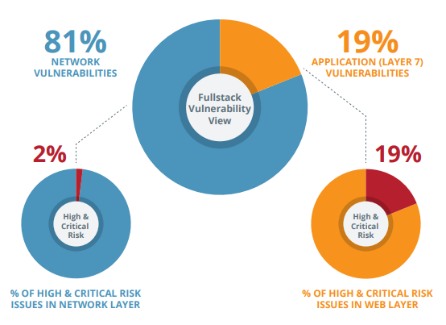
RISK DENSITY – INFRASTRUCTURE VS LAYER 7
In 2018 Dublin Ireland based Full Stack Vulnerability Management Company “Edgescan” discovered that on average, 19% of all vulnerabilities were associated with (Layer 7) web applications, API’s, etc., and 81% were network vulnerabilities. Out of 19% Layer 7 vulnerabilities, 19% were of highly critical nature. On the other hand, out of 81% Network vulnerabilities 2% were of highly critical nature.

Slide 4
Software and Security
Software provides functionality
E.g., on-line exam results
This functionality comes with certain risks
E.g., what are risks of on-line exam results?
User Privacy Compromise
Data Integrity Compromise
User Access Compromise
Software security is about managing these risks by regulating access to assets
E.g., information or functionality

Slide 5
Vulnerable Software Security Risks
Vulnerable Software exposes confidential data to un-authenticate users
Vulnerable Software crashes or grinds to a halt when exposed to faulty inputs
Vulnerable Software allows an attacker to inject code and execute it
Vulnerable Software executes privileged commands for an attacker

Slide 6
Why Not Building a Fortress?
Security is always a secondary concern
Primary goal of software is to provide functionalities or services. Hence, there is often a trade-off/conflict between
security
functionality & convenience
Managing associated risks is a derived/secondary concern
Security achievement is hard to evaluate when nothing bad happens

Slide 7
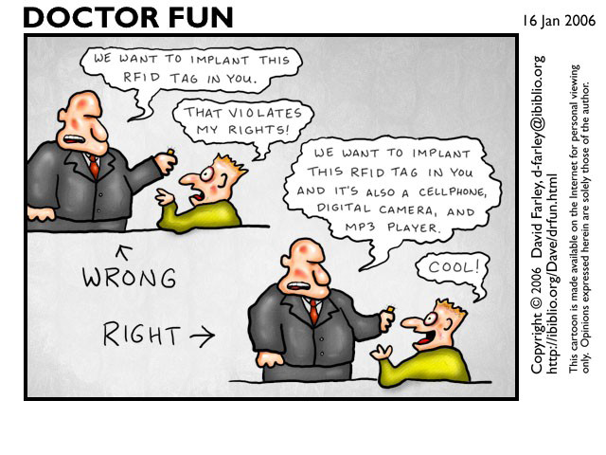
Functionality vs Security

Slide 8
Software Vulnerability and Software Bugs
Software Bugs and Design Flaws are directly related to Software Vulnerabilities.
CWE is a Software Assurance strategic initiative sponsored by the National Cyber Security Division of the U.S. Department of Homeland Security, which is dedicated to track and analyze software vulnerabilities.

Slide 9
Common Weakness Enumeration CWE™
The top 25 CWE identified Most Dangerous Software Errors form a demonstrative list of the most widespread and critical weaknesses that can lead to serious vulnerabilities in software.
To create the list, the CWE Team used a data-driven approach that leverages published Common Vulnerabilities and Exposures (CVE®) data and related CWE mappings found within the National Institute of Standards and Technology (NIST) National Vulnerability Database (NVD), as well as the Common Vulnerability Scoring System (CVSS) scores associated with each of the CVEs. A scoring formula was then applied to determine the level of prevalence and danger each weakness presents.
Source: https://cwe.mitre.org/top25/archive/2019/2019_cwe_top25.html

Slide 10
2019 CWE Identified Top 25 Software Vulnerabilities and Corresponding Frequency [CWE: Common Weakness Enumeration]

Slide 11
2019 CWE Identified Top 25 Software Vulnerabilities and Corresponding Frequency [CWE: Common Weakness Enumeration]

Slide 12
2019 CWE Identified Additional Software Vulnerabilities and Corresponding Frequency [CWE: Common Weakness Enumeration]

Slide 13
Security Breaches - Terminology
Exposure
A form of possible loss or harm
Vulnerability
A weakness in the system
Attack
An external intrusion
Threats
Human attacks, natural disasters, errors
Control
A protective measure
Assets
HW, SW, Data

Slide 14
Types of Security Breaches
Disclosure: unauthorized access to info
Snooping
Deception: acceptance of false data
Modification, spoofing, repudiation of origin, denial of receipt
Disruption: prevention of correct operation
Modification, man-in-the-middle attack
Usurpation: unauthorized control of some part of the system (usurp: take by force or without right)
Modification, spoofing, delay, denial of service

Slide 15
Security Components
Confidentiality: The assets are accessible only by authorized parties.
Keeping data and resources hidden
Integrity: The assets are modified only by authorized parties, and only in authorized ways.
Data integrity (integrity)
Origin integrity (authentication)
Availability: Assets are accessible to authorized parties.
Enabling access to data and resources

Slide 16
Characteristics of Computer Intrusion
A computing system: a collection of hardware, software, data, and people that an organization uses to do computing tasks. Intrusion can take place in numerous ways:
Any piece of the computing system can become the target of a computing crime.
The weakest point is the most serious vulnerability.
The principles of easiest penetration

Slide 17
Characteristics of Computer Intrusion
Destroyed (deleted) software
Stolen (pirated) software
Altered (but still run) software
Logic bomb
Trojan horse
Virus
Trapdoor
Information leaks

Slide 18
Data Security
The principle of adequate protection
The principle of adequate protection means that computers, and the information stored upon or transmitted by them, must be protected to a degree commensurate with their value and the value of that information.
Storage of encryption keys
Software versus hardware methods

Slide 19
Other Exposed Assets
Storage media
Networks
Access
Key people

Slide 20
Origin of Vulnerabilities
Networked Software is not designed to withstand a hostile environment
Development tools do not prevent simple security bugs (i.e., buffer overflows)
QA Testing methods do not address security
Customers pay for bad software
Notes:
First real programs were made only 50 years ago

Slide 21
Getting Worse
In order to compete, new services must be delivered
New technology is not being properly tested for failures
More connections, devices, and code

Slide 22
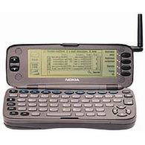
More Devices
What happens when buffer overflows and poor access controls lead to mobile code attacks on cellular phones?
Mobile code can effect distributed systems in a matter of hours

Slide 23
More Connections
New protocols, delivery mediums
A high degree of connectivity makes it possible for small failures to propagate and lead to massive outages
Telephone network outages
Power system grid failures
Notes:
1980 ARPAnet collapse. Hardware omission (no memory parity), flaky garbage collection, two hardware errors, propagated to entire net: four-hour outage.
Internet service outages. 1997 black hole due to routing table error: 50,000 addresses pointing to one site. 1986 Northeast disconnect.
Network Solutions Internet domain table error blocks .com and .net for four hours.
1990 AT&T long-distance calling blockage due to SS7 software flaw: crashes propagated incessantly for 11 hours.
1998 AT&T packet-data frame-relay network collapsed US-wide: faulty software upgrade gave 26-hour black-hole effect.
More Large-Scale Case Histories - - - - - - - - - - - - - - - - - - - Summer 1996 Western power outages: 2 July 1996 over 10 Western states (tree, operator, propagation). 10 August 1996 affected 8 million customers in 8 states, Canada, Baja.
May 1998 Galaxy IV satellite failure, primary and backup systems both failed, disabling 40M pager systems, etc. Reconfiguration problematic, moving satellites or antennas, reprogramming, ...
1997 Kansas City power outage triggered national air-traffic snarl: operator shutdown wrong system half in preventive maintenance. Many other air-traffic propagation effects.

Slide 24
More Exposure
Massive increase in connectivity
A vast network of relationships
Arpanet started with 12 nodes
Machines that used to work behind closed doors are now exposed
Computers are now worn on belt-loops
Notes:
The CLEC’s are like an extranet – they have to be trusted – this is regulated.

Slide 25
More Code
Technology is being ‘glued’ together
More feature rich, more drivers and libraries
In 1983, Microsoft word was only 27,000 LOC
Code Size
400,000 Solaris 7
17 million Netscape
40 million Space Station
10 million Space Shuttle
7 million Boeing 777
35 million NT5
Under 5 million Windows 95
1.5 million Linux
Notes:
1980 ARPAnet collapse. Hardware omission (no memory parity), flaky garbage collection, two hardware errors, propagated to entire net: four-hour outage.
Internet service outages. 1997 black hole due to routing table error: 50,000 addresses pointing to one site. 1986 Northeast disconnect.
Network Solutions Internet domain table error blocks .com and .net for four hours.
1990 AT&T long-distance calling blockage due to SS7 software flaw: crashes propagated incessantly for 11 hours.
1998 AT&T packet-data frame-relay network collapsed US-wide: faulty software upgrade gave 26-hour black-hole effect.
More Large-Scale Case Histories - - - - - - - - - - - - - - - - - - - Summer 1996 Western power outages: 2 July 1996 over 10 Western states (tree, operator, propagation). 10 August 1996 affected 8 million customers in 8 states, Canada, Baja.
May 1998 Galaxy IV satellite failure, primary and backup systems both failed, disabling 40M pager systems, etc. Reconfiguration problematic, moving satellites or antennas, reprogramming, ...
1997 Kansas City power outage triggered national air-traffic snarl: operator shutdown wrong system half in preventive maintenance. Many other air-traffic propagation effects.

Slide 26
Software is always in the “bleeding edge” phase
Windows 2000 shipped with 63,000 known bugs

Slide 27
Remote Capability
Do any of the native calls operate over the network?
Domain specification
Data source specification
Ip address
NTFS Path name

Slide 28
Vulnerable Authentication
Response aggregation
User/password enumeration when errors differ
No lockout
Brute force
Failed logging
Alternative requests
Can you specify a remote domain or target?
Proxied attacks

Slide 29
Vulnerable Filesystem
Can you control a filesystem path
What is the entire set of characters?
Can you create files in a target directory
Create files that will be interpreted in a server context
Can you use remote pathname
//machine_name/etc

Slide 30
Execution Flaws
Code Insertion
State Corruption
Fatal Exception

Slide 31
Architecture Flaws
No authentication
Lack of randomness
Lack of modularity with strong coupling
Bad configuration or design
Race conditions
Absence of proxy servers
No redundancy or fall back

Slide 32
Methods of Defense
Encryption
Software controls
Hardware controls
Policies
Physical controls

Slide 33
Encryption
At the heart of all security methods is the confidentiality of data
Some protocols rely on encryption to ensure availability of resources.
But, be advised that encryption does not solve all computer security problems by itself.

Slide 34
Encryption
DES/3DES or TripleDES: This is an encryption algorithm called Data Encryption Standard that was first used by the U.S. Government in the late 70's. It is commonly used in ATM machines (to encrypt PINs) and is utilized in UNIX password encryption. Triple DES or 3DES has replaced the older versions as a more secure method of encryption, as it encrypts data three times and uses a different key for at least one of the versions.
Blowfish: Blowfish is a symmetric block cipher that is unpatented and free to use. It was developed by Bruce Schneier and introduced in 1993.

Slide 35
Encryption
AES: Advanced Encryption Standard or Rijndael; it uses the Rijndael block cipher approved by the National Institute of Standards and Technology (NIST). AES was originated by cryptographers Joan Daemen and Vincent Rijmen and replaced DES as the U.S. Government encryption technique in 2000.
Twofish: Twofish is a block cipher designed by Counterpane Labs. It was one of the five Advanced Encryption Standard (AES) finalists and is unpatented and open source.

Slide 36
Encryption
IDEA: This encryption algorithm was used in Pretty Good Privacy (PGP) Version 2 and is an optional algorithm in OpenPGP. IDEA features 64 bit blocks with a 128 bit key.
MD5: It was developed by Professor Ronald Riverst and was used to create digital signatures. It is a one way hash function and intended for 32 bit machines. It replaced the MD4 algorithm.

Slide 37
Encryption
SHA 1: SHA 1 is a hashing algorithm similar to MD5, yet SHA 1 may replace MD5 since it offers more security
HMAC: This is a hashing method similar to MD5 and SHA 1, sometimes referred to as HMAC MD5 and HMAC SHA1.

Slide 38
Encryption
RSA Security: Rivest, Shamir, and
A public-key encryption technology developed by RSA Data Security, Inc. The acronym stands for Rivest, Shamir, and Adelman, the inventors of the technique. The RSA algorithm is based on the fact that there is no efficient way to factor very large numbers.
Realistically, the security of RSA itself is generally the least of your concerns in designing a system that uses it. In fact, that's true of nearly all reasonably modern encryption algorithms. ... Instead, you typically use RSA in conjunction with some symmetric-key (aka private key) encryption algorithm such as AES.

Slide 39
Encryption
RC4 RC4 is a variable key size stream cipher based on the use of a random permutation.
RC5 This is a parameterized algorithm with a variable block, key size and number of rounds.
RC6 This an evolution of RC5, it is also a parameterized algorithm that has variable block, key and a number of rounds. This algorithm has integer multiplication and 4 bit working registers.

Slide 40
Software controls
Software controls are usually the 1st aspects of computer security that come to mind.
Internal program controls
OS controls
Development controls

Slide 41
Unit Testing
Data validation
Fuzzing: Fuzzing or fuzz testing is an automated software testing technique that involves providing invalid, unexpected, or random data as inputs to a computer program. The program is then monitored for exceptions such as crashes, failing built-in code assertions, or potential memory leaks.
SQL injection
Buffer overflows
Cross site scripting
Authorization
Method level permissions

Slide 42
Unit Testing
Cross site scripting: Cross-site scripting (XSS) is a type of computer security vulnerability typically found in web applications. XSS enables attackers to inject client-side scripts into web pages viewed by other users. Across-site scripting vulnerability may be used by attackers to bypass access controls such as the same-origin policy.
Authorization
Method level permissions

Slide 43
QA Testing
Integrate with existing bug tracking systems
No high / medium / low!
Go with Severity / Priority ratings
Follow the existing process
Treat security bugs no different than other bugs
Well maybe a little different ;)

Slide 44
QA Testing
Tag security bugs
Maybe used to ensure developer assigned to fix is “security conscious”
Classify by security frame
Allows root cause and other statistical analyses
Classify by nature
Bugs
Flaws
Commendations
Informational
Mark for regression testing

Slide 45
Overlapping Controls
Several different controls may apply to one potential exposure.
H/w control + S/w control + Data control

Slide 46
Policies and Mechanisms
Policy says what is, and is not, allowed
This defines “security” for the site/system/etc.
Mechanisms enforce policies
Mechanisms can be simple but effective
Example: frequent changes of passwords
Composition of policies
If policies conflict, discrepancies may create security vulnerabilities
Legal and ethical controls
Gradually evolving and maturing

Slide 47
Organizational Drivers
Regulatory compliance
SOX 404: Sarbanes-Oxley Act
HIPAA: Health Insurance Portability and Accountability Act
PCI: Payment card industry
GLBA
CA SB1386 / State Notification Laws
BASEL II
FISMA
EU Data Protection Directive
…
Industry regulations and standards
FFIEC
OWASP Top 10 / Guides
SCADA Security
OASIS
ISO 17799
…

Slide 48
Organizational Drivers
SOX Section 404 (Sarbanes-Oxley Act Section 404) mandates that all publicly-traded companies must establish internal controls and procedures for financial reporting and must document, test and maintain those controls and procedures to ensure their effectiveness. The purpose of SOX is to reduce the possibilities of corporate fraud by increasing the stringency of procedures and requirements for financial reporting.
HIPAA (Health Insurance Portability and Accountability Act of 1996) is United States legislation that provides data privacy and security provisions for safeguarding medical information. The law has emerged into greater prominence in recent years with the proliferation of health data breaches caused by cyberattacks and ransomware attacks on health insurers and providers.

Slide 49
Organizational Drivers
The Payment Card Industry Data Security Standard (PCI DSS) is a set of security standards designed to ensure that ALL companies that accept, process, store or transmit credit card information maintain a secure environment. The Payment Card Industry Security Standards Council (PCI SSC) was launched on September 7, 2006 to manage the ongoing evolution of the Payment Card Industry (PCI) security standards with a focus on improving payment account security throughout the transaction process. The PCI DSS is administered and managed by the PCI SSC (www.pcisecuritystandards.org), an independent body that was created by the major payment card brands (Visa, MasterCard, American Express, Discover and JCB.). It is important to note that the payment brands and acquirers are responsible for enforcing compliance, not the PCI council.

Slide 50
Organizational Drivers
Company policies / documents
Privacy policy
Coding standards
Patching policy
Data classification policy
Infosec policies
Acceptable use policies
Export control
Results from previous security audits
…
Security features
Authentication
Authorization
Administrative interfaces
User management
…

Slide 51
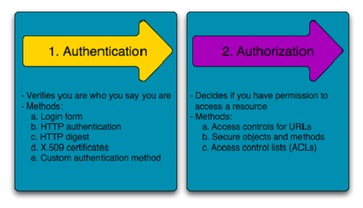
Organizational Drivers
Authentication means confirming your own identity, while authorization means granting access to the system.
In simple terms, authentication is the process of verifying who you are, while authorization is the process of verifying what you have access to.

Slide 52
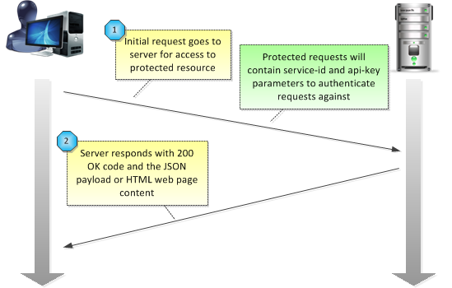
Verify before Trust
Verify before Trust: Login Authentication

Slide 53
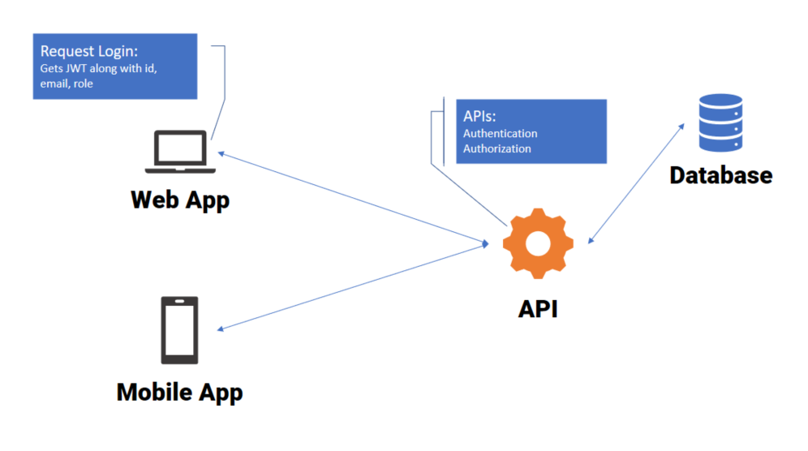
Trust but Verify
Trust but Verify: API Authentication

Slide 54
Goals of Security
Prevention
Prevent attackers from violating security policy
Detection
Detect attackers’ violation of security policy
Recovery
Stop attack, assess and repair damage
Continue to function correctly even if attack succeeds
Notes:
Prevention is ideal, because then there are no successful attacks.
Detection occurs after someone violates the policy. The mechanism determines that a violation of the policy has occurred (or is underway), and reports it. The system (or system security officer) must then respond appropriately.
Recovery means that the system continues to function correctly, possibly after a period during which it fails to function correctly. If the system functions correctly always, but possibly with degraded services, it is said to be intrusion tolerant. This is very difficult to do correctly; usually, recovery means that the attack is stopped, the system fixed (which may involve shutting down the system for some time, or making it unavailable to all users except the system security officers), and then the system resumes correct operations.

Slide 55
Tying together
Threats
Policy
Specification
Design
Implementation
Operation

Slide 56
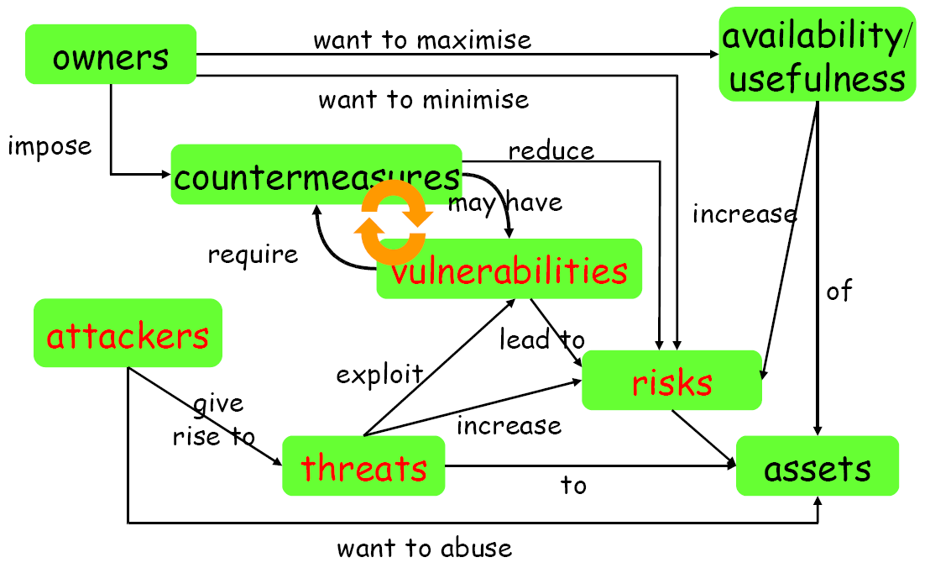
Security Concept

Slide 57
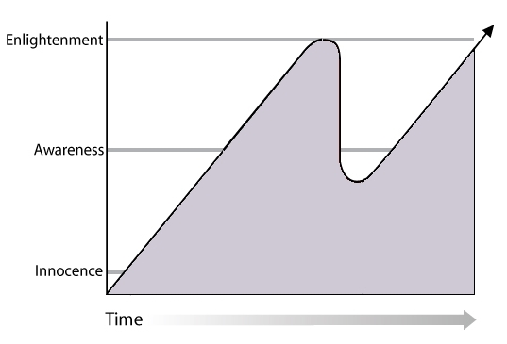
Security Concept
People
Process
technology

